Slide 1
Detection of suicide ideation in social media forums
Batch : 02
Guide : Dr. Shaik Fathimabi
Presented By :
Nikhileswar.K
Vishal.D
Sphoorthi.L

Slide 2
ABSTRACT
While multiple initiatives have been developed and implemented for suicide prevention, a key challenge has been the social stigma associated with mental disorders, which deters patients from seeking help or sharing their experiences directly with others including clinicians. This is particularly true for teenagers and younger adults where suicide is the second highest cause of death[2]. However, people are more willing to express themselves on social media and forums without having to face someone directly. This large amount of data on people’s feelings and behaviors can be used successfully for early detection of suicidal behavior. The objective of our project is to present an automatic recognition of suicidal posts with the help of deep learning classification approaches using spark. The dataset is collected by taking posts from “SuicideWatch” and “depression” subreddits of Reddit. Using spark-streaming data can be processed in real-time to detect suicidal and depression thoughts and can help in early detection of suicidal and depression thoughts.

Slide 3
Problem statement
India accounts for 17.8% of all reported suicide cases[1]. Online discussion forums have become a place for people to express suicidial ideas and this can be used to detect early suicidal thoughts and prevent them. The objective of this project is to develop efficient methods to identify suicidal and depression thoughts in social media forums and to use them in detection of depression and suicidal feelings by using historical data to identify suicidal and depression texts and to use spark streaming to identify suicidal contents in real-time.

Slide 4
Dataset: We will introduce a new dataset prepared by collecting posts from “SuicideWatch” and “depression” subreddits of the Reddit platform.
Unigram analysis: unigram analysis shows that suicide-related conversations are discussed in the “SuicideWatch” subreddit and other topics in the “teenagers” subreddit.
Feature analysis: we evaluate the performance of word embeddings, TF-IDF, bag-of-words over Universal Sentence Encoder.
Comparative evaluation: we compare the performance of our proposed USE-FCNN method and compare its performance with deep learning methods like LSTM, LSTM-CNN, and traditional machine learning models like SVM and XGBoost.
Contributions

Slide 5
Literature review
Year && Journal | Paper Name | Technology | Results | Limitations
2017 ACM | Detecting Changes in Suicide Content Manifested in Social Media Following Celebrity Suicides[3] -Mrinal Kumar | N-gram analysis, topic model analysis. | Able to identify Werther effect and demonstrate increase in posting activity post-suicide | Cannot assess how increased activity on SW compares with increased attempted or completed suicides.
2018 Hindawi | Supervised Learning for Suicidal Ideation Detection in Online User Content[4] -Shaoxiong Ji | LIWC, XGBoost, LSTM, MLFFNN | Random forest gains better performance than most models except for the metric of precision in which the MLFFNN gains a slightly better result | Data collection is expensive, simple feature sets and classification models are not predictive enough to detect suicidal tendencie.
2020 npj Digital Medicine | A machine learning approach predicts future risk to suicidal ideation from social media data[5] -Arunima Roy | Random Forest, Neural Networks | Using nine neural networks, no psychological construct is unrepresented as each is accurately measured above 70% by at least one model. | Lack of information regarding demographic and socioeconomic characteristics of the participants, specifically related to race, ethnicity, or nationality data. Algorithm is limited to twitter.

Slide 6
Year && Journal | Paper Name | Technology | Results | Limitations
2019 J Med Internet Res | Suicidal Ideation Detection via Social Media Analytics[9] -Yan Huang | MFWF, LIWC, SVM. | Based on MFWF method they achieved better performances than data-driven method. Recall increased from 0.78 to 0.88 by 12.8% | Single social media site, single blogs, Did not include other feature selection methods.
2018 Research and Development | Detection of suicide-related posts in twitter data streams[10] -M.J.Vioules | Feature extraction for text scoring-NLP based approach,. | The NLP text-scoring approach successfully separates out tweets exhibiting distress-related content and acts as a powerful input into the martingale framework. | The features used to determine the mental health of a user may differ between individuals. Tested only on two users
2020 J Med Internet Res | Detection of Suicidal Ideation on Social Media: Multimodal, Relational, and Behavioral Analysis[7] - Diana Ramir-Cifuentes | CNN, BOW, N-grams. | Findings also show that the combination of textual, visual, relational, and behavioral data outperforms the accuracy of using each modality separately. | Results can be improved by enhancing the models based on textual and relational features.

Slide 7
Year && Journala | Paper Name | Technology | Results | Limitations
2017 IEEE | A Comprehensive Study on Social Network Mental Disorders Detection via Online Social Media Mining[12]. -Shuai | Stochastic Gradient Descent Algorithm. | Proposed an SNMDD framework that explores various features from data logs of OSNs and a new tensor technique for deriving latent features from multiple OSNs for SNMD detection. | Compromises user engagement, modern techniques based on NLP and CV can give better results.
2020 Algorithms | Detection of Suicide Ideation in Social Media Forums Using Deep Learning[13] -Tadesse | LSTM-CNN, XGBoost, LSTM. | LSTM-CNN based model was able to outperform other algorithms while IDF+BOW were good as features compared to other features like TF-IDF and Statistics | Data Deficiency as there is not enough annotated data.
2018 Elsevier | A Large-Scale Sentiment Data Classification for Online Reviews Under Apache Spark[14]-Alsaqqa | Naive Bayes, SVM | SVM outperfomed Naive Bayes and Logistic Regression with an accuracy of 86% as the dataset used is a balanced dataset. | Poor performance of model on larger datasets.

Slide 8
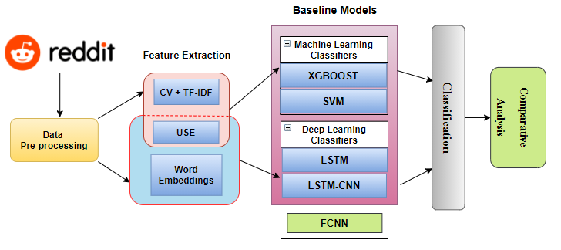
Architecture diagram

Slide 9


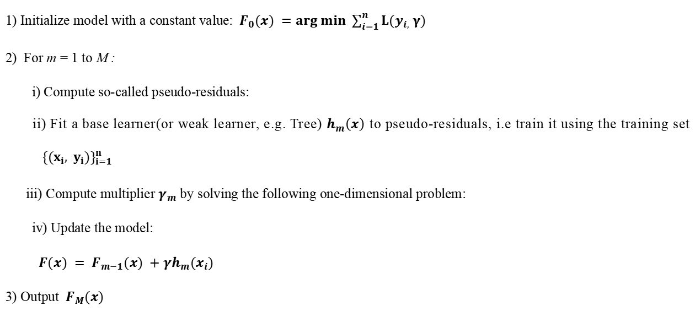
Algorithms
XGBOOST
1) Initialize model with a constant value:${ F}_{0}(x) =arg min \sum_{i=1}^{n}{L(y_{i,} γ)}$
2) For m = 1 to M :
i) Compute so-called pseudo-residuals:
ii) Fit a base learner(or weak learner, e.g. Tree) $h_{m}\left(x\right)$ to pseudo-residuals, i.e train it using the training set ${ \{(x_{i}, y_{i})\}}_{i=1}^{n}$
iii) Compute multiplier $γ_{m}$ by solving the following one-dimensional problem:
iv) Update the model:
$F(x) = F_{m−1}(x) +γh_{m}(x_{i})$
3) Output $F_{M}(x)$

Slide 10
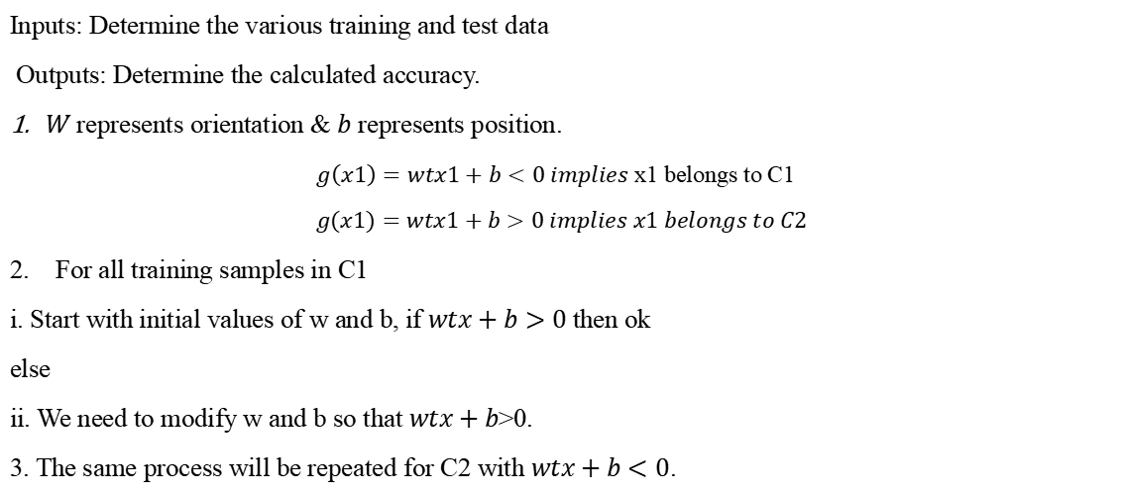
Support Vector Machine(SVM)
Inputs: Determine the various training and test data
Outputs: Determine the calculated accuracy.
$W$ represents orientation & $b$ represents position.
$g\left(x1\right)=wtx1+b<0 implies$ x1 belongs to C1
$$g(x1)=wtx1+b>0 implies x1 belongs to C2$$
2. For all training samples in C1
i. Start with initial values of w and b, if $wtx+b>0$then ok
else
ii. We need to modify w and b so that $wtx+b$>0.
3. The same process will be repeated for C2 with $wtx+b<0$.

Slide 11
Algorithms
Gradient Descent
Step 1: Initialize the weights(a & b) with random values and calculate Error (SSE).
Step 2: Calculate the gradient i.e. change in SSE when the weights (a & b) are changed by a very small value from their original randomly initialized value. This helps us move the values of a & b in the direction in which SSE is minimized.
Step 3: Adjust the weights with the gradients to reach the optimal values where SSE is minimized
Step 4: Use the new weights for prediction and to calculate the new SSE.
Step 5: Repeat steps 2 and 3 till further adjustments to weights doesn’t significantly reduce the Error.

Slide 12
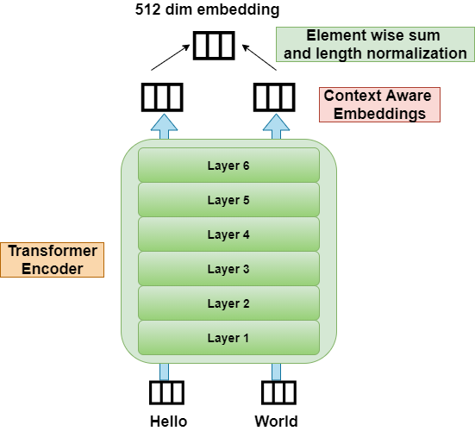
Universal Sentence Encoder (USE)
The Universal Sentence Encoder encodes text into high dimensional vectors that can be used for text classification, semantic similarity, clustering and other natural language tasks.
The model is trained and optimized for greater-than-word length text, such as sentences, phrases or short paragraphs. It is trained on a variety of data sources and a variety of tasks with the aim of dynamically accommodating a wide variety of natural language understanding tasks. The input is variable length English text, and the output is a 512-dimensional vector.

Slide 13
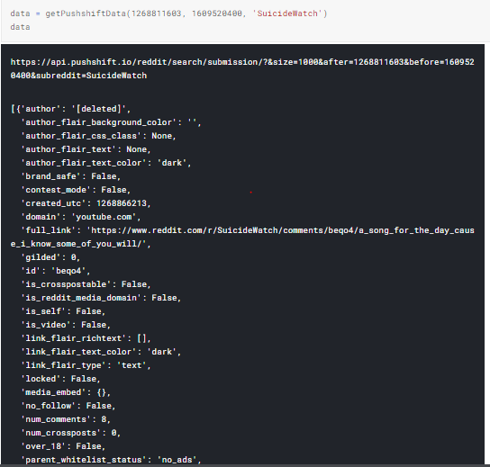
Implementation steps
IMPLEMENTATION STEPS
The dataset is a collection of posts from ‘SuicideWatch’[2], depression[3]’ and ‘teenagers[4]’ subreddits of the Reddit platform. The data is collected using the Push-shift API. Push-shift API[5] uses URLs to extract posts from a subreddit of Reddit along with title, body, creation time etc..
XGBoost, SGD, and USE are trained and evaluated to identify the best performing model.

Slide 14
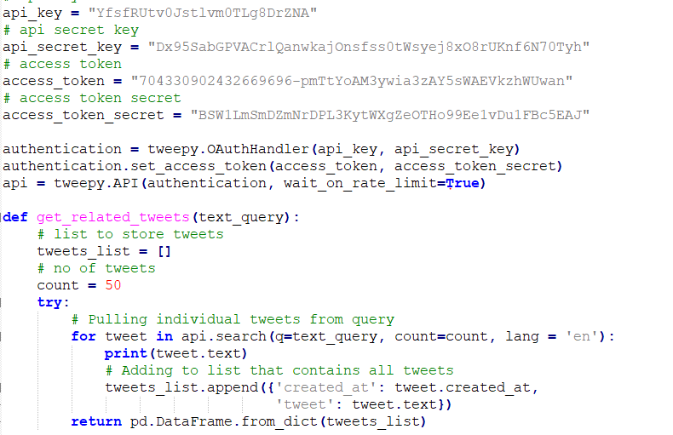
Implementation steps
IMPLEMENTATION STEPS
Tweets can be extracted in real-time using the Tweepy API[6]. Tweepy is an official twitter API available for python to extract tweets based on key-words.
The model weights can be saved as a joblib file and can be used in deployment for prediction without having to train again.
Flask was used to deploy the model on to the local host. We can either extract real-time tweets from twitter and classify them based on key-words or provide a single paragraph or sentence as an input and predict whether it is associated with suicide or depression.

Slide 15
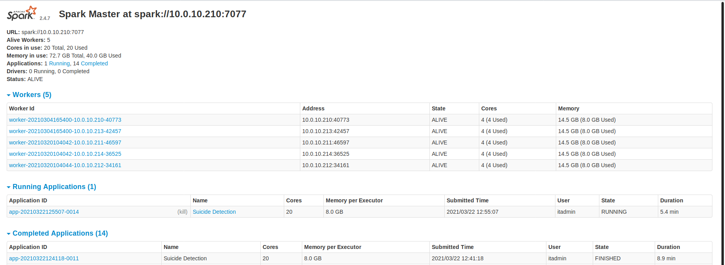
Iimplementation in Apache spark using 5 nodes

Slide 16
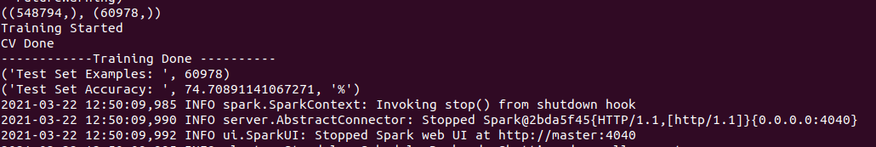
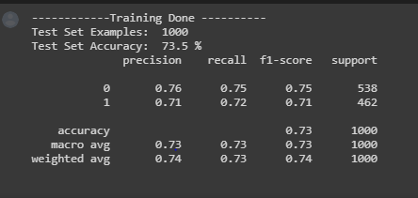
Results obtained
XGBoost Performance in Multinode using Spark
XGBoost Performance

Slide 17
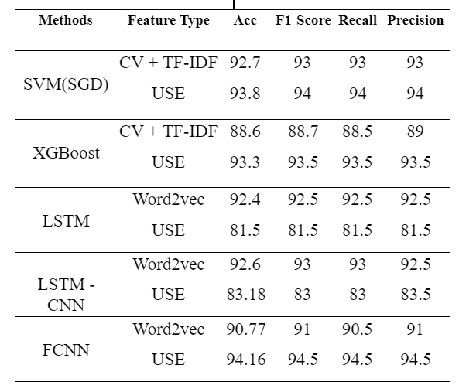
results of various algorithms

Slide 18
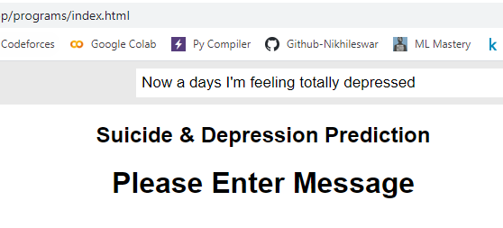
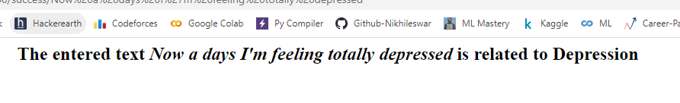
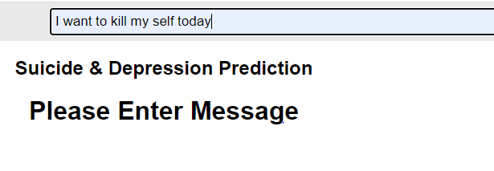
Results obtained

Slide 19
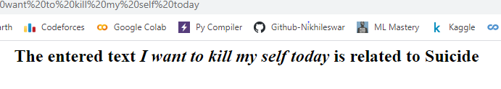
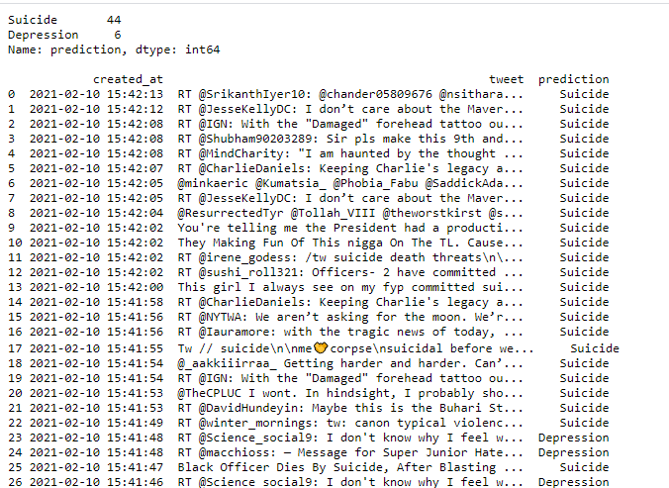
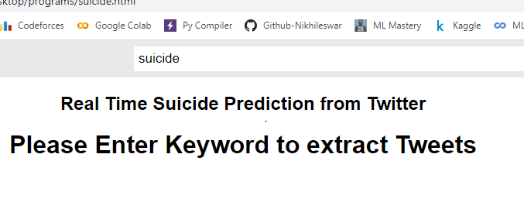
Results obtained

Slide 20
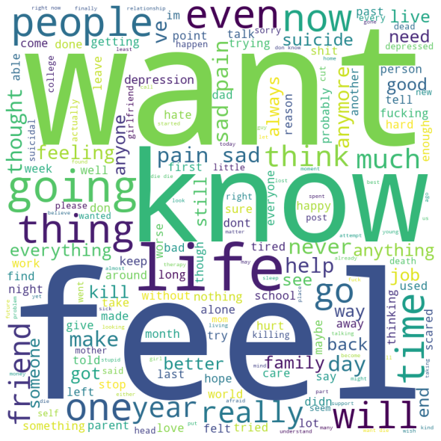
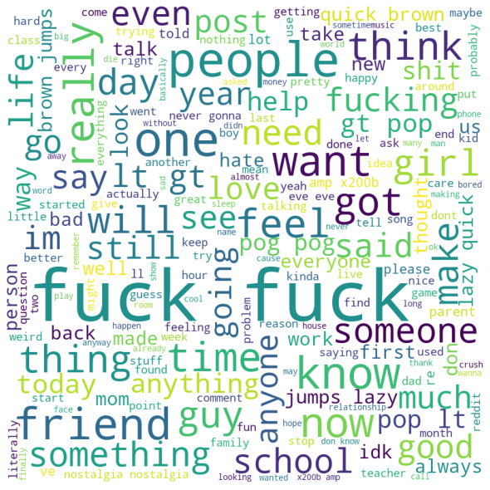
Unigram analysis

Slide 21
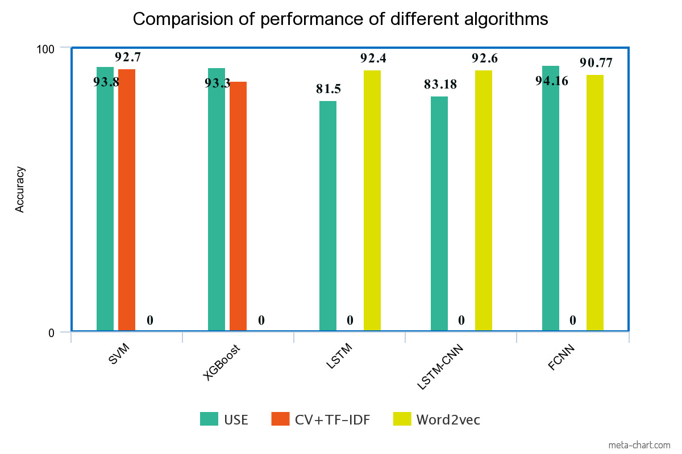

Slide 22
Status of publication
We have completed writing both major and mini research papers and have applied to these journals which are under-review.
1. Expert Systems with applications
2. Journal of Applied Science and Engineering
For, Mini project paper we applied to ICICIT and ICSCN Conferences and waiting for their acceptance.

Slide 23
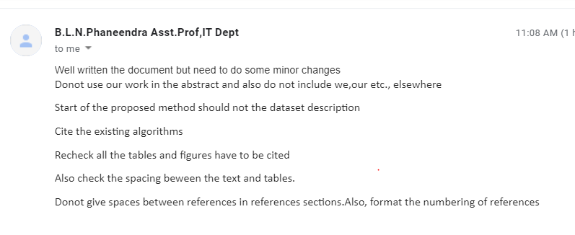
COMMENTS PROVIDED BY GUIDE

Slide 24
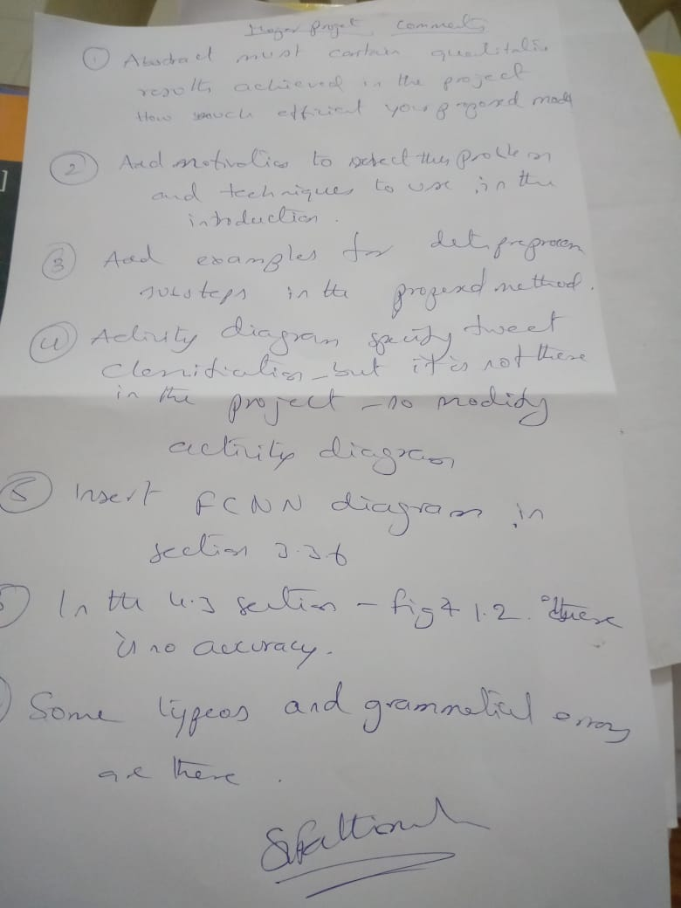
Comments provided by guide

Slide 25
conclusion
The project’s main motive is to detect suicide-related content on social media forums very effectively to help early suicide detection. We have proposed a better approach that outperforms other baseline models.
The high performance of the method can be attributed to the Universal Sentence Encoder, which is being used to encode the text, and provide input to the Feed Forward Neural Network.
The limitation of the work can be found in the data deficiency. Also, our work assumes that the posts mentioned in the ‘SuicideWatch’ subreddit are potential suicidal content, and posts from the ‘teenagers’ subreddit are non-suicidal content that cannot always be true. Since the data is vast, we did not perform human annotations for the data.
The present study only focuses on the classification of text data written in the English language. In the future, more supported languages can be added. The introduction of manual data annotations can help in improving the results.

Slide 26
References
[1] Tadesse, Michael & Lin, Hongfei & Xu, Bo & Yang, Liang. (2019). Detection of Suicide Ideation in Social Media Forums Using Deep Learning. Algorithms. 13. 7. 10.3390/a13010007.
[2] Shuai, Hong-Han & Shen, Chih-Ya & Yang, De-Nian & Lan, Yi-Feng & Lee, Wang-Chien & Yu, Philip & Chen, Ming-Syan. (2017). A Comprehensive Study on Social Network Mental Disorders Detection via Online Social Media Mining. IEEE Transactions on Knowledge and Data Engineering. PP. 1-1. 10.1109/TKDE.2017.2786695.
[3] Kumar M, Dredze M, Coppersmith G, De Choudhury M. Detecting Changes in Suicide Content Manifested in Social Media Following Celebrity Suicides. HT ACM Conf Hypertext Soc Media. 2015 Sep;2015:85-94. doi: 10.1145/2700171.2791026. PMID: 28713876; PMCID: PMC5507358.
[4] Ji, Shaoxiong & Yu, Celina & Fung, Sai-fu & Pan, Shirui & Long, Guodong. (2018). Supervised Learning for Suicidal Ideation Detection in Online User Content. Complexity. 2018. 1-10. 10.1155/2018/6157249.

Slide 27
References
[5] Roy, A., Nikolitch, K., McGinn, R. et al. A machine learning approach predicts future risk to suicidal ideation from social media data. npj Digit. Med. 3, 78 (2020).
[6]Sawhney, Ramit et al. “A Time-Aware Transformer Based Model for Suicide Ideation Detection on Social Media.” EMNLP (2020).
[7]Ramírez-Cifuentes D, Freire A, Baeza-Yates R, Puntí J, Medina-Bravo P, Velazquez DA, Gonfaus JM, Gonzàlez J Detection of Suicidal Ideation on Social Media: Multimodal, Relational, and Behavioral Analysis J Med Internet Res 2020;22(7):e17758
[8] O'Dea, Bridianne & Wan, Stephen & Batterham, Philip & Calear, Alison & Paris, Cécile & Christensen, Helen. (2015). Detecting Suicidality on Twitter. Internet Interventions. 103. 10.1016/j.invent.2015.03.005.
[9]Huang Y., Liu X., Zhu T. (2019) Suicidal Ideation Detection via Social Media Analytics. In: Milošević D., Tang Y., Zu Q. (eds) Human Centered Computing. HCC 2019. Lecture Notes in Computer Science, vol 11956. Springer, Cham. https://doi.org/10.1007/978-3-030-37429-7_17

Slide 28
References
[10] M. J. Vioulès, B. Moulahi, J. Azé and S. Bringay, "Detection of suicide-related posts in Twitter data streams," in IBM Journal of Research and Development, vol. 62, no. 1, pp. 7:1-7:12, 1 Jan.-Feb. 2018, doi: 10.1147/JRD.2017.2768678.
[11] Jashinsky, Jared & Burton, Scott & Hanson, Carl & West, Josh & Giraud-Carrier, Christophe & Barnes, Michael & Argyle, Trenton. (2013). Tracking Suicide Risk Factors Through Twitter in the US. Crisis. 35. 1-9. 10.1027/0227-5910/a000234.
[12]diatimes.com/life-style/health-fitness/de-stress/the-soaring-rate-of-teen-suicides-what-can-we-learn/articleshow/78032936.cms
[13] American Foundation for Suicide Prevention (AFSP). [Online]. Available: https://afsp.org
[14] Alsaqqa, Samar & Al-Naymat, Ghazi & Awajan, Arafat. (2018). A Large-Scale Sentiment Data Classification for Online Reviews Under Apache Spark. Procedia Computer Science. 141. 183-189. 10.1016/j.procs.2018.10.166.
[15] https://www.reddit.com/r/SuicideWatch/
[16] https://pypi.org/project/praw/
[17] Devlin, Jacob & Chang, Ming-Wei & Lee, Kenton & Toutanova, Kristina. (2018). BERT: Pre-training of Deep Bidirectional Transformers for Language Understanding.

Slide 29


